Slide 1
Chapter 12: Other Quality Attributes
Pingjian Zhang
School of Software Engineering, SCUT
2018

Slide 2
Chapter Outline
Other Important Quality Attributes
Other Categories of Quality Attributes
Software Quality Attributes and System Quality Attributes
Using Standard Lists of Quality Attributes
Dealing with “X-ability”
Summary

Slide 3
Other Important Quality Attributes
Variability: is a special form of modifiability. It refers to the ability of a system and its supporting artifacts to support the production of a set of variants that differ from each other in a preplanned fashion.
Portability: is also a special form of modifiability. Portability refers to the ease with which software that built to run on one platform can be changed to run on a different platform.
Development Distributability: is the quality of designing the software to support distributed software development.
Notes:
美国程序员外包给中国程序员

Slide 4
Other Important Quality Attributes
Scalability: Horizontal scalability (scaling out) refers to adding more resources to logical units such as adding another server to a cluster. Vertical scalability (scaling up) refers to adding more resources to a physical unit such as adding more memory to a computer.
Deployability: is concerned with how an executable arrives at a host platform and how it is invoked.
Mobility: deals with the problems of movement and affordances of a platform (e.g. size, type of display, type of input devices, availability and volume of bandwidth, and battery life).
Notes:
高铁、飞机打电话

Slide 5
Other Important Quality Attributes
Monitorability: deals with the ability of the operations staff to monitor the system while it is executing.
Safety: Software safety is about the software’s ability to avoid entering states that cause or lead to damage, injury, or loss of life, and to recover and limit the damage when it does enter into bad states. The architectural concerns with safety are almost identical with those for availability (i.e. preventing, detecting, and recovering from failures).

Slide 6
Other Categories of Quality Attributes
Conceptual Integrity: refers to consistency in the design of the architecture. It contributes to the understandability of the architecture. Conceptual integrity demands that the same thing is done in the same way through the architecture.
Marketability: Some systems are marketed by their architectures, and these architectures sometimes carry a meaning all their own, independent of what other quality attributes they bring to the system (e.g. service-oriented or cloud-based).
Notes:
网格计算->云计算

Slide 7
Other Categories of Quality Attributes
Quality in Use: qualities that pertain to the use of the system by various stakeholders. For example
Effectiveness: a measure whether the system is correct
Efficiency: the effort and time required to develop a system
Freedom from risk: degree to which a product or system affects economic status, human life, health, or the environment

Slide 8
Software Quality Attributes and System Quality Attributes
Physical systems, such as aircraft or automobiles or kitchen appliances, that rely on software embedded within are designed to meet a whole other litany of quality attributes: weight, size, electric consumption, power output, pollution output, weather resistance, battery life, and on and on.
The software architecture can have a substantial effect on the system’s quality attributes.

Slide 9
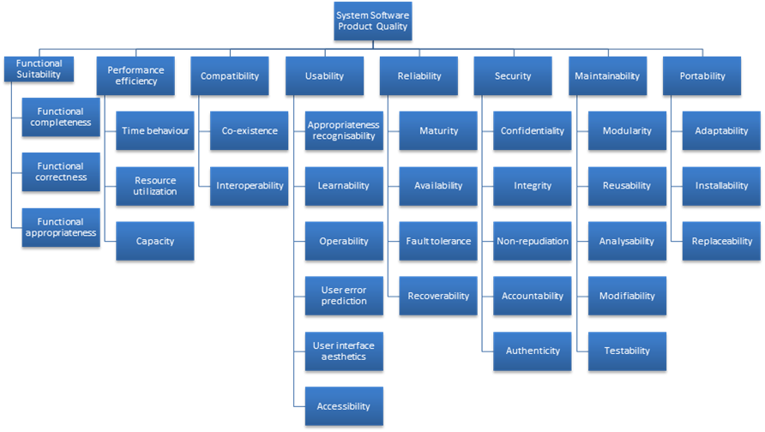
Standard Lists of Quality Attributes
ISO/IEC FCD 25010 Product Quality Standard

Slide 10
Standard Lists of Quality Attributes
Advantages:
Can be helpful checklists to assist requirements gatherers in making sure that no important needs were overlooked.
Can serve as the basis for creating your own checklist that contains the quality attributes of concern.

Slide 11
Standard Lists of Quality Attributes
Disadvantages:
No list will ever be complete.
Lists often generate more controversy than understanding.
Lists often purport to be taxonomies. But what is a denial-of-service attack?
They force architects to pay attention to every quality attribute on the list.

Slide 12
Dealing with “X-ability”
Suppose you must deal with a quality attribute for which there is no compact body of knowledge, e.g. green computing.
What do you do?
Model the quality attribute
Assemble a set of tactics for the quality attribute
Construct design checklists
Notes:
绿色计算：机房建在山区、北极、深海…
自适应性
稳定性

Slide 13
Summary
There are many other quality attributes than the seven that we cover in detail.
Taxonomies of attributes may offer some help, but their disadvantages often outweigh their advantages.
You may need to design or analyze a system for a “new” quality attribute. While this may be challenging, it is doable.

